Slide 1

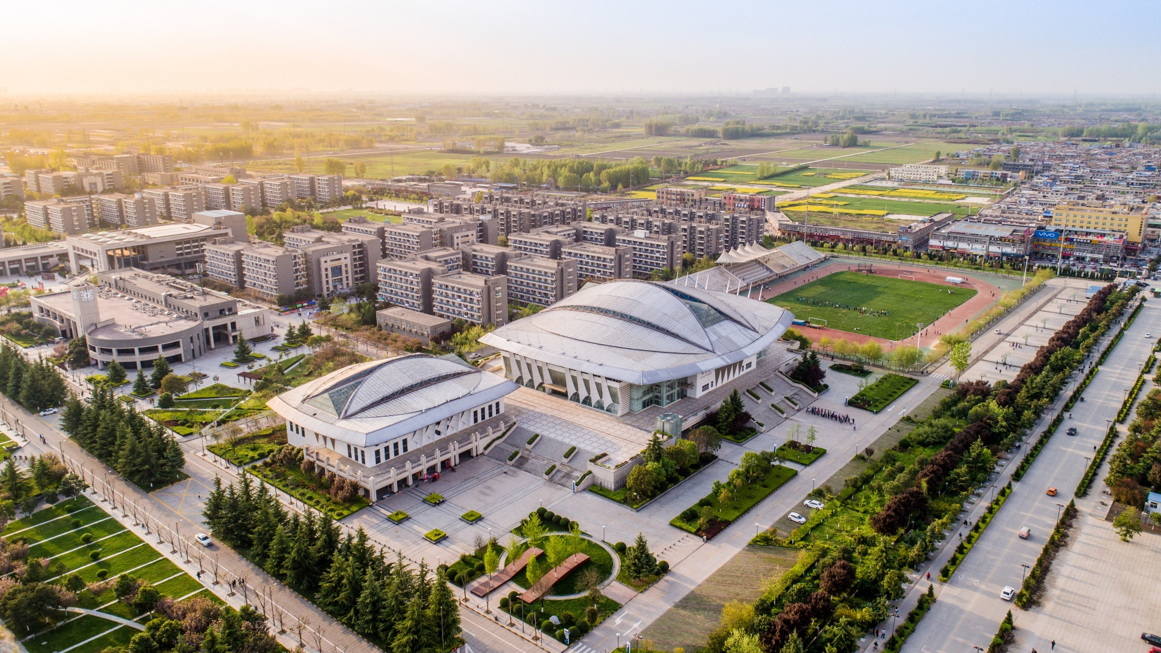
Project Management
From Theory to Practice
School of Management Zhi Chen
9/28/2021
Northwestern Polytechnical University

Slide 2
Before the class
Clsss:
4 times,
Online class,
No examination,
Class homework (3 times).
Requirement:
Attend the class on time,
Finish the homework by yourself (no copy, no plagiarization),
Hand in the homework before the dead line.
The grade for this class will be given depending on class attendance and homework.

Slide 3


contents
01
Introduction
02
Project Network
03
Critical Path Method
04
Program Evaluation and Review Technique
05
Project Simulation

Slide 4
The evolution of project management
1
The Cold War
The use of project management was then mandated for some of the smaller weapon systems such as jet fighters and tanks. NASA mandated the use of project management for all activities related to the space program.
By 1970 and the early 1980s
More companies departed from informal project management and restructured to formalize the project management process, mainly because the size and complexity of their activities had grown to a point where they were unmanageable within the current structure.
2
By the 1990s
Companies had begun to realize that implementing project management was a necessity, not a choice. Companies finally began to recognize the benefits of project management.
3
4
2008-2021
From 2008 to 2016, many companies saw a slowdown in company’s growth. some companies recognized that the benefits of using project management could help them develop strategic partnerships, alliances, and joint ventures, thus providing growth opportunities.

Slide 5
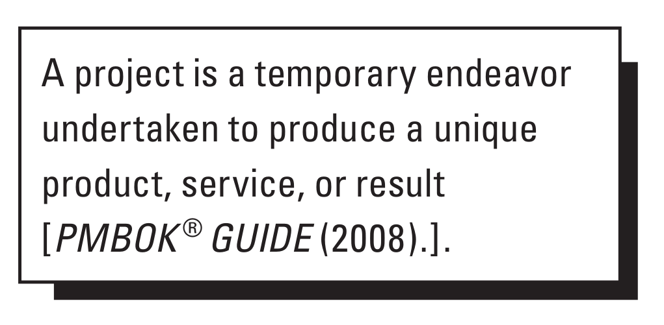
What is a project?
A project can be considered to be any series of activities and tasks that:
Have a specific objective, with a focus on the creation of business value, to be completed within certain specifications
Have defined start and end dates
Have funding limits (if applicable)
Consume human and nonhuman resources (i.e., money, people, equipment)
Are multifunctional (i.e., cut across several functional lines)
Examples of projects:
• Developing a new product, service, or result;
• Effecting a change in the structure, processes, staffing, or style of an organization;
• Developing or acquiring a new or modified information system;
• Conducting a research effort whose outcome will be aptly recorded;
• Constructing a building, industrial plant, or infrastructure;
• Implementing, improving, or enhancing existing business processes and procedures.

Slide 6
Project management
Project management is the application of knowledge, skills, and tools necessary to achieve the project’s requirements. The knowledge, skills, and tools are usually grouped into activities or processes.
Project initiation
Project planning
Selection of the best project given resource limits
recognizing the benefits of the project
Preparation of the documents to sanction the project
Assigning of the project manager
Definition of the work requirements
Definition of the quality and quantity of work
Definition of the resources needed
Scheduling the activities
Evaluation of the various risks
Project execution
Project monitoring and control
Negotiating for the project team members
Directing and managing the work
working with the team members to help them improve
Tracking progress
Comparing actual outcome to predicted outcome
Analyzing variances and impacts
Making adjustments
Project closure
Verifying that all of the work has been accomplished
Contractual closure of the contract
Financial closure of the charge numbers
Administrative closure of the paperwork

Slide 7
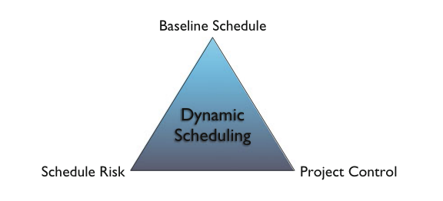

Dynamic project scheduling
Our class…
Computer Aid
The three components of dynamic project scheduling

Slide 8
Dynamic project scheduling
Scheduling: Construct a timetable to provide a start and end date for each project activity, taking activity relations, resource constraints and other project characteristics into account and aiming at reaching a certain scheduling objective.
Risk Analysis: Analyze the strengths and weaknesses of the project schedule in order to obtain information about the schedule sensitivity and the impact of unexpected changes that undoubtedly occur during project progress on the project objective.
Control: Measure the (time and cost) performance of a project during its progress and use the information obtained during the scheduling and risk analysis steps to monitor and update the project and to take corrective actions in case of problems.

Slide 9
Validating the project objectives
Project objectives are described in specific terms, are measureable, and are attainable and action-oriented, realistic, and bound by time.
1
Specific
What are the major elements of the work required to satisfy the objectives, and how are these elements interrelated?
Which functional divisions will assume responsibility for accomplishment of these objectives and the major element work requirements?
Are the required corporate and organizational resources available?
What are the information flow requirements for the project?
2
Measurable
SAMAT
RULE
3
Attainable
4
Realistic or relevant
5
Tangible or time bound

Slide 10






Scope management
Project scope management processes include the following:
Plan scope management: The process of creating a scope management plan that documents how the project scope will be defined, validated, and controlled.
Collect requirements: The process of determining, documenting, and managing stakeholder needs and requirements to meet project objectives.
Define scope: The process of developing a detailed description of the project and product.
Create WBS: The process of subdividing project deliverables and project work into smaller, more manageable components.
Validate Scope: The process of formalizing acceptance of the completed project deliverables.
Control Scope: The process of monitoring the status of the project and product scope and managing changes to the scope baseline.

Slide 11
Work breakdown structure
In planning a project, the project manager must structure the work into small elements that are:
Manageable, in that specific authority and responsibility can be assigned
Independent, or with minimum interfacing with and dependence on other ongoing elements
Integratable so that the total package can be seen
Measurable in terms of progress
Identifying and analyzing the deliverables and related work;
Structuring and organizing the WBS;
Decomposing the upper WBS levels into lower-level detailed components;
Developing and assigning identification codes to the WBS components;
Verifying that the degree of decomposition of the deliverables is appropriate.

Slide 12
Define activities
Define activities is the process of identifying and documenting the specific actions to be performed to produce the project deliverables. The key benefit of this process is to break down work packages into activities that provide a basis for estimating, scheduling, executing, monitoring, and controlling the project work.
The Create WBS process identifies the deliverables at the lowest level in the WBS—the work package. Work packages are typically decomposed into smaller components called activities that represent the work effort required to complete the work package. Activities represent the effort needed to complete a work package. The Define Activities process defines the final outputs as activities rather than deliverables.
Define Activities: outputs
Activity List: includes all schedule activities required on the project.
Activity Attributes: activity durations, resources and costs associated with that work.
Milestone List: A milestone is a significant point or event in a project. A milestone list is a list identifying all project milestones and indicates whether the milestone is mandatory,

Slide 13
Estimate activity time
Expert Judgment
Analogous Estimating
Expert judgment, guided by historical information, can provide duration estimate information or recommended maximum activity durations from prior similar projects.
Analogous estimating is a technique for estimating the duration or cost of an activity or a project using historical data from a similar activity or project.
Parametric Estimating
Three-Point Estimating
Parametric estimating is an estimating technique in which an algorithm is used to calculate cost or duration based on historical data and project parameters.
The accuracy of single-point activity duration estimates may be improved by considering estimation uncertainty and risk. PERT uses three estimates to define an approximate range for an activity’s duration: most likely, optimistic, pessimistic.
For example, if the assigned resource is capable of installing 25 meters of cable per hour, the duration required to install 1,000 meters is 40 hours.

Slide 14
Estimate activity resources
Alternative Analysis
Many schedule activities have alternative methods of accomplishment. They include using various levels of resource capability or skills, different size or type of machines, different tools (hand versus automated), and make- rent-or-buy decisions regarding the resource
02
Published Estimating data
Expert Judgment
Any group or person with specialized knowledge in resource planning and estimating can provide such expertise.
03
Several organizations routinely publish updated production rates and unit costs of resources for an extensive array of labor trades, material, and equipment for different countries and geographical locations within countries.
01
04
05
Project Management Software
Bottom-up Estimating
Project management software has the capability to help plan, organize, and manage resource pools and develop resource estimates.
The work within the activity is decomposed into more detail. The resource needs are estimated. These estimates are then aggregated into a total quantity for each of the activity’s resources.

Slide 15
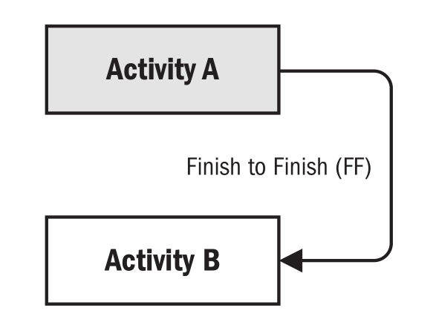

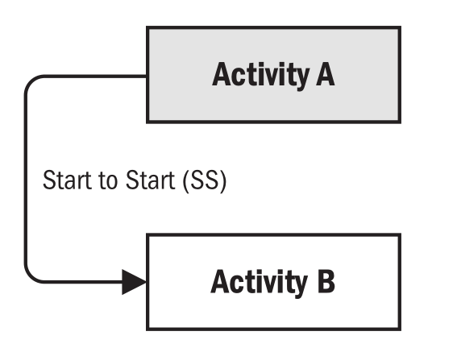
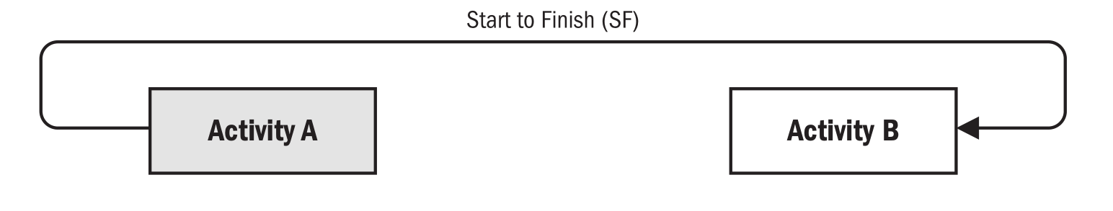
Sequence activities
Sequence activities is the process of identifying and documenting relationships among the project activities. The key benefit of this process is that it defines the logical sequence of work to obtain the greatest efficiency given all project constraints.
Finish-to-finish (FF)
Finish-to-start (FS)
Start-to-start (SS)
Start-to-finish (SF)

Slide 16
Activity information
Activity Information
Activity Information:
Activity
Duration
Resource
Cost
Sequence Activity
Finish-Start (FS)
Start-Start（SS）、Start-Finish（SF）、Finish-Finish（FF）
Resource Available
Activity | Immediate Successor | Duration/Month | Resource | Cost
A | B,C,D | 0 | 0 | 0
B | E | 4 | 7 | 80
C | J | 9 | 3 | 36
D | F | 1 | 2 | 25
E | I | 4 | 7 | 80
F | G | 5 | 2 | 20
G | H,K | 1 | 9 | 120
H | L | 7 | 2 | 21
I | L | 8 | 1 | 8
J | L | 3 | 1 | 6
K | L | 3 | 5 | 60
L |  | 0 | 0 | 0

Slide 17
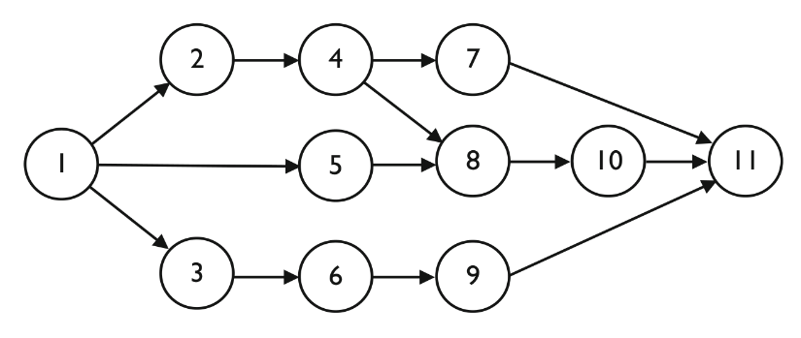
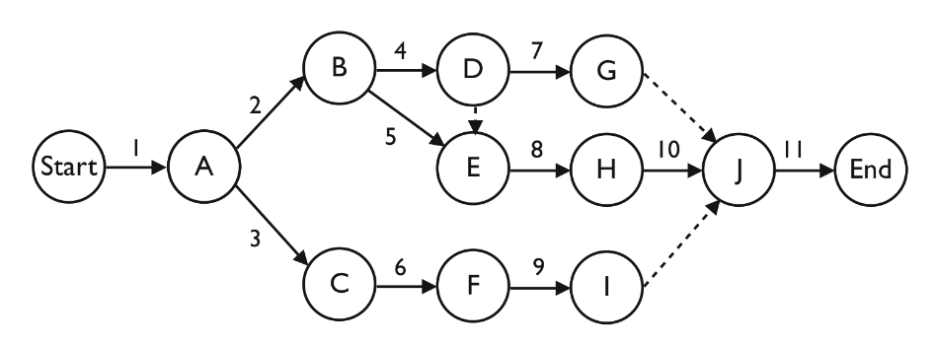
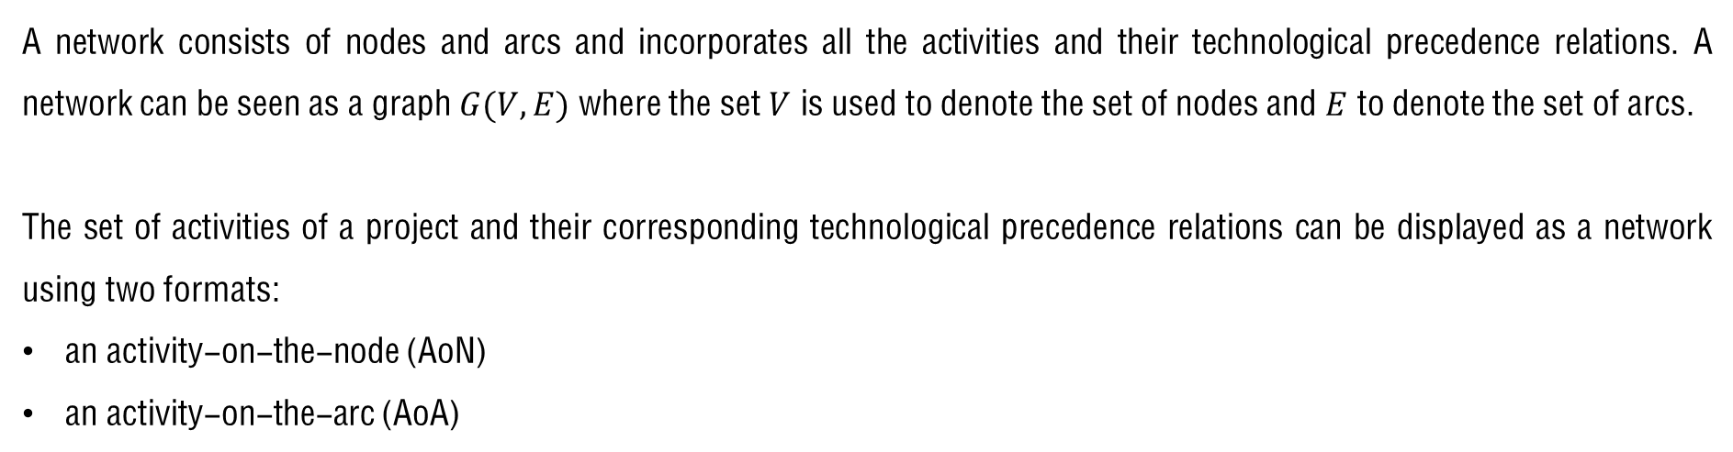
Project network
A network consists of nodes and arcs and incorporates all the activities and their technological precedence relations. A network can be seen as a graph $G(V,E)$ where the set $V$ is used to denote the set of nodes and $E$ to denote the set of arcs.
The set of activities of a project and their corresponding technological precedence relations can be displayed as a network using two formats:
an activity-on-the-node (AoN)
an activity-on-the-arc (AoA)

Slide 18
Activity on the node
An AoN network displays the activities by nodes and precedence relations by arcs. The three steps to follow in order to construct an AoN network are:
Draw a node for each network activity.
Draw an arc for each immediate precedence relation between two activities.
Possibly add a dummy start and dummy end node to force that the network begins with a single start activity and finishes with a single end activity.
Activity | Predecessors | Successors
A |  | B,C
B | A | D
C | A | D,E
D | B,C | F
E | C
F | D

Slide 19
Rules for constructing AoN networks
The logic between activities must be right
No cycles
No two-headed arrows and no connecting lines without arrow
No arrow line without a start node or an end node

Slide 20
Rules for constructing AoN networks
No crossing arrow line is preferable
The network has only a start node and only a end node
The label for each node is unique, and ordered according to the logic

Slide 21
Activity on the node
Lets try
Give the AoN network of the following project
Activity | Immediate successor
1 | 3
2 | 5
3 | 6,7
4 | 7
5 | 8
6
7 | 9
8
9

Slide 22
Activity on the arc
In an AoA format, activities are displayed by means of arcs in the network. The nodes are events (or milestones) denoting the start and/or finish of a set of activities of the project.
Activity | Predecessors | Successors
A |  | B,C
B | A | D
C | A | D,E
D | B,C | F
E | C
F | D
3-4 is dummy activity

Slide 23
Rules for constructing AoA networks
The logic between activities must be right
No cycles
No two-headed arrows and no connecting lines without arrow
No arrow line without a start node or an end node

Slide 24
Rules for constructing AoA networks
No crossing arrow line is preferable
The network has only a start node and only a end node
The label for each node is unique, and ordered according to the logic

Slide 25
Dummy activity of AoA
The introduction of dummy activities is often necessary to model all precedence relations.
Any two events may be directly connected by no more than one activity.
A<C，B<D，B<C
Use of dummy activities

Slide 26
AoA project networks are not unique
Precedence between activities
Activity | Immediate successor
A | B,C
B | D,E
C | E
D | F
E | F
F
AoA solution 1
AoA solution 2

Slide 27
Activity on the arc
Lets try
Give the AoA network of the following project
Activity | Predecessors
A
B | A
C | A
D | B
E | B
F | C
G | D
H | D,E
I | F
J | H
K | G,I,J

Slide 28
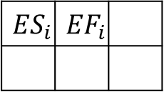
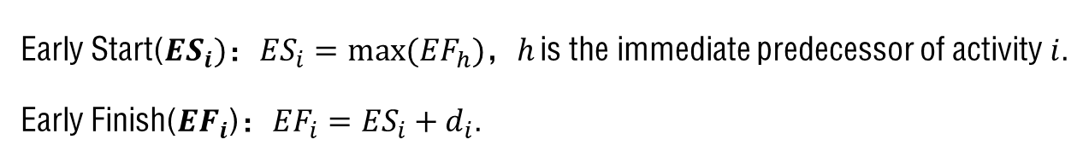
Critical Path Method——AoN network
Early Start(${ES}_{i})$：${ES}_{i}=max⁡({EF}_{h})$，$h$ is the immediate predecessor of activity $i$.
Early Finish(${EF}_{i}$)：${EF}_{i}={ES}_{i}+d_{i}$.
2 | 5
5 | 9
9 | 15
0 | 2
18 | 26
$${ES}_{i}$$ | $${EF}_{i}$$
2 | 7
7 | 11
11 | 18
AoN project network

Slide 29
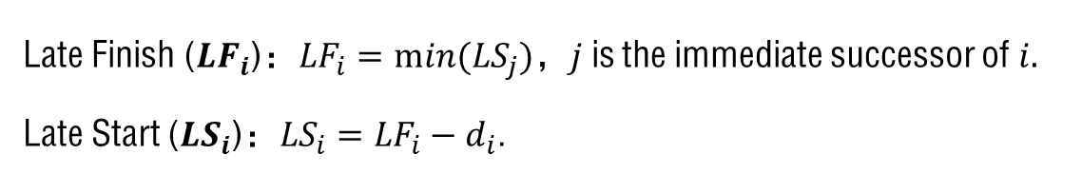
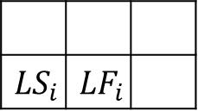
Critical Path Method——AoN network
Late Finish (${LF}_{i}$)：${LF}_{i}=min⁡({LS}_{j})$，$j$is the immediate successor of $i.$
Late Start (${LS}_{i}$)：${LS}_{i}={LF}_{i}−d_{i}$.
4 | 7
7 | 11
12 | 18
0 | 2
18 | 26
$${LS}_{i}$$ | $${LF}_{i}$$
2 | 7
7 | 11
11 | 18
AoN project network

Slide 30
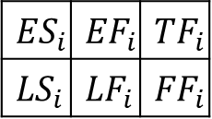
Critical Path Method——AoN network
Total Float (${TF}_{i})$: the total slack denotes the allowable time delay of an activity without causing a delay in the project. ${TF}_{i}={LS}_{i}−{ES}_{i}={LF}_{i}−{EF}_{i}$.
Free Float (${FF}_{i}):$the allowable delay in the activity finish time without affecting the earliest possible start time of all immediate successors. ${FF}_{i}={min (ES}_{j})$-${EF}_{i}$, $j$ is the immediate successor of activity $i$.
2 | 5 | 2
4 | 7 | 0
5 | 9 | 2
7 | 11 | 0
9 | 15 | 3
12 | 18 | 3
0 | 2 | 0
0 | 2 | 0
18 | 26 | 0
18 | 26 | 0
$${ES}_{i}$$ | $${EF}_{i}$$ | $${TF}_{i}$$
$${LS}_{i}$$ | $${LF}_{i}$$ | $${FF}_{i}$$
2 | 7 | 0
2 | 7 | 0
7 | 11 | 0
7 | 11 | 0
11 | 18 | 0
11 | 18 | 0
AoN project network

Slide 31
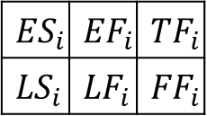
Critical Path Method——AoN network
The critical path is the longest path of the project network，activities on the critical path is the critical activities。The total float of activity reflects the degree of sensitivity to the project duration，critical activity has zero total slack.
2 | 5 | 2
4 | 7 | 0
5 | 9 | 2
7 | 11 | 0
9 | 15 | 3
12 | 18 | 3
0 | 2 | 0
0 | 2 | 0
18 | 26 | 0
18 | 26 | 0
$${ES}_{i}$$ | $${EF}_{i}$$ | $${TF}_{i}$$
$${LS}_{i}$$ | $${LF}_{i}$$ | $${FF}_{i}$$
2 | 7 | 0
2 | 7 | 0
7 | 11 | 0
7 | 11 | 0
11 | 18 | 0
11 | 18 | 0
Critical path of the Project

Slide 32
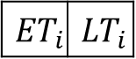
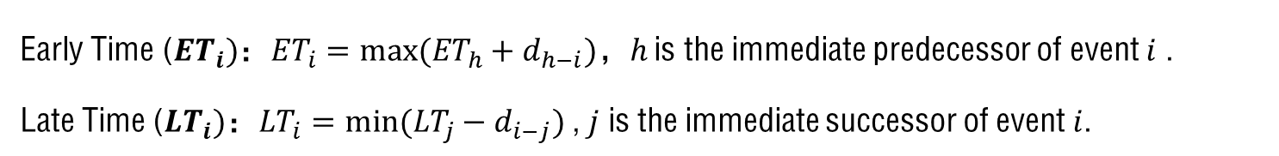
Critical Path Method——AoA network
Early Time (${ET}_{i})$：${ET}_{i}=max⁡({ET}_{h}+d_{h−i})$，$h$ is the immediate predecessor of event $i$ .
Late Time (${LT}_{i})$：${LT}_{i}=min⁡({LT}_{j}−d_{i−j})$, $j$ is the immediate successor of event $i$.
5 | 7
9 | 11
0 | 0
2 | 2
18 | 18
26 | 26
7 | 7
11 | 11
$${ET}_{i}$$ | $${LT}_{i}$$

Slide 33
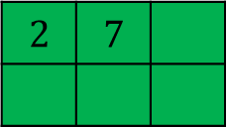
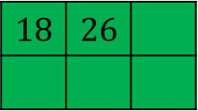
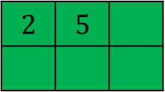
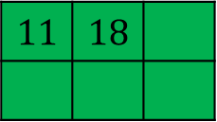
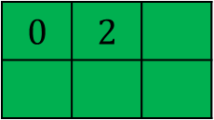
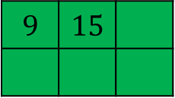
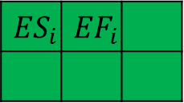
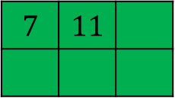
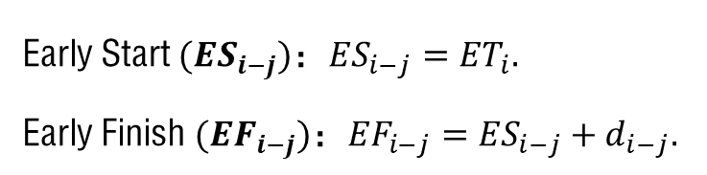
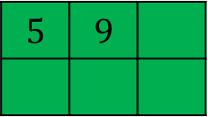
Critical Path Method——AoA network
Early Start $({ES}_{i−j})$：${ES}_{i−j}={ET}_{i}.$
Early Finish $({EF}_{i−j})$：${EF}_{i−j}={ES}_{i−j}+d_{i−j}.$
$$5$$ | $$9$$
$$2$$ | $$5$$
5 | 7
9 | 11
$$9$$ | $$15$$
$$18$$ | $$26$$
0 | 0
2 | 2
18 | 18
26 | 26
$$0$$ | $$2$$
$$2$$ | $$7$$
$$11$$ | $$18$$
7 | 7
11 | 11
$${ES}_{i}$$ | $${EF}_{i}$$
$$7$$ | $$11$$

Slide 34
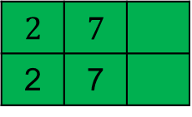
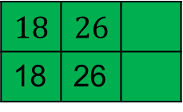
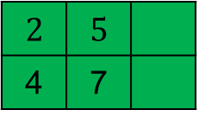
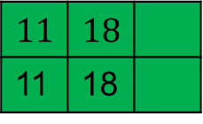
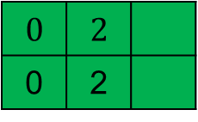
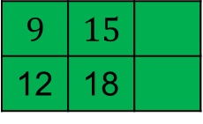
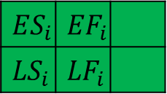
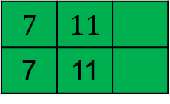
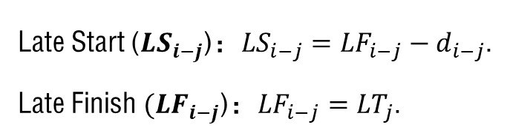
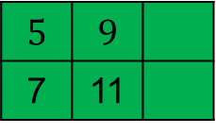
Critical Path Method——AoA network
Late Start (${LS}_{i−j}$)：${LS}_{i−j}={LF}_{i−j}−d_{i−j}$.
Late Finish $({LF}_{i−j}$)：${LF}_{i−j}={LT}_{j}$.
$$5$$ | $$9$$
7 | 11
$$2$$ | $$5$$
4 | 7
5 | 7
9 | 11
$$9$$ | $$15$$
12 | 18
$$18$$ | $$26$$
18 | 26
0 | 0
2 | 2
18 | 18
26 | 26
$$0$$ | $$2$$
0 | 2
$$2$$ | $$7$$
2 | 7
$$11$$ | $$18$$
11 | 18
7 | 7
11 | 11
$${ES}_{i}$$ | $${EF}_{i}$$
$${LS}_{i}$$ | $${LF}_{i}$$
$$7$$ | $$11$$
7 | 11

Slide 35
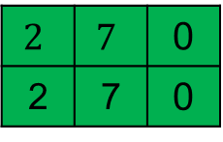
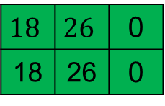
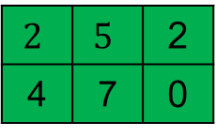
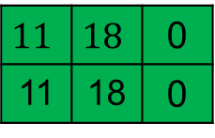
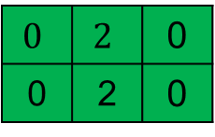
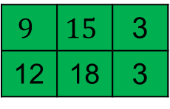
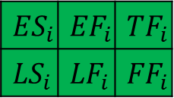
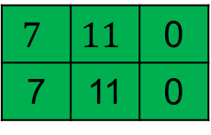
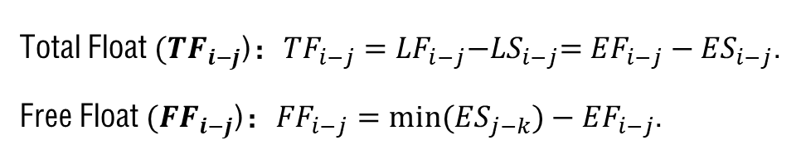
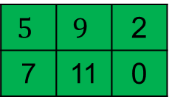
Critical Path Method——AoA network
Total Float $({TF}_{i−j}$)：${TF}_{i−j}={LF}_{i−j}{−LS}_{i−j}={EF}_{i−j}−{ES}_{i−j}$.
Free Float $({FF}_{i−j}$)：${FF}_{i−j}={min⁡(ES}_{j−k})−{EF}_{i−j}$.
$$5$$ | $$9$$ | 2
7 | 11 | 0
$$2$$ | $$5$$ | 2
4 | 7 | 0
5 | 7
9 | 11
$$9$$ | $$15$$ | 3
12 | 18 | 3
$$18$$ | $$26$$ | 0
18 | 26 | 0
0 | 0
2 | 2
18 | 18
26 | 26
$$0$$ | $$2$$ | 0
0 | 2 | 0
$$2$$ | $$7$$ | 0
2 | 7 | 0
$$11$$ | $$18$$ | 0
11 | 18 | 0
7 | 7
11 | 11
$${ES}_{i}$$ | $${EF}_{i}$$ | $${TF}_{i}$$
$${LS}_{i}$$ | $${LF}_{i}$$ | $${FF}_{i}$$
$$7$$ | $$11$$ | 0
7 | 11 | 0

Slide 36
Time/cost trade-off problems
CPM
The majority of activities encountered in real-life projects can be performed in shorter or longer durations by increasing or decreasing the resources (manpower, facilities, money, etc.) available to them
Assumes that resources are available in ‘infinite’ amounts
Direct activity cost function
Normal activity duration: most efficient resource allocation
Crash duration: maximum allocation of resources
Objective: minimize total project costs = direct + indirect costs
Project indirect costs: supervision, overhead, interest charges on cumulative project investment, penalty costs for late completion, bonuses for early completion

Slide 37
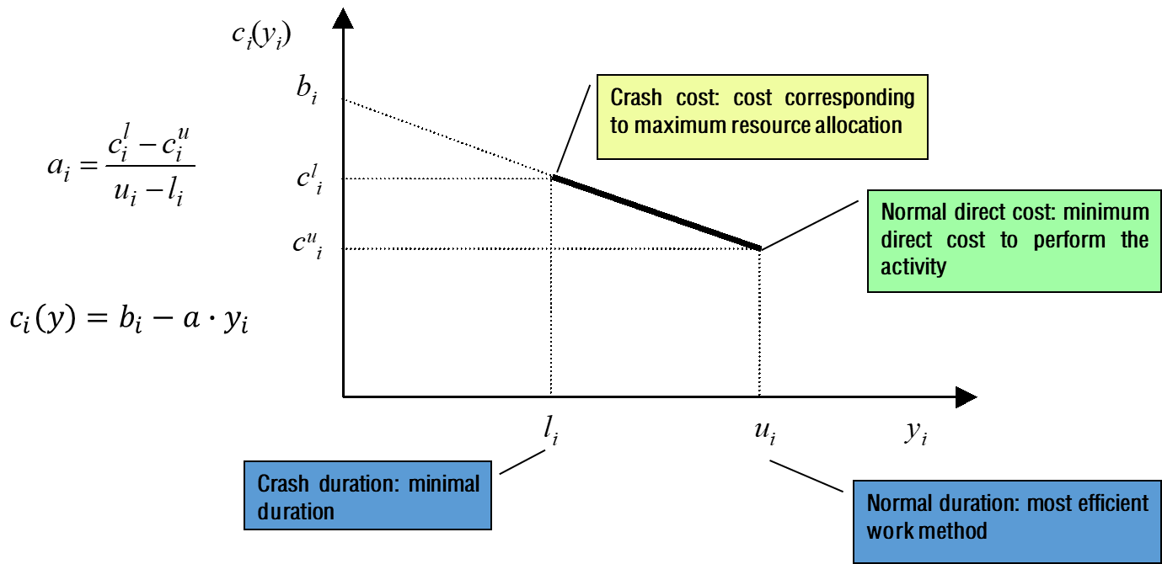
Time/cost trade-off problems
When the length of critical path excels the project due date, project manager should consider crash the project duration. CPM assumes that the duration of project activities is a nonincreasing function of the amount of money used to perform this activity.
A CPM project scheduling model assumes four pieces of information for each project activity, as follows:
Normal Duration (ND): The maximum duration for the activity.
Crash Duration (CD): The minimum duration for the activity.
Normal Cost (NC): The cost associated with the normal duration.
Crash Cost (CC): The cost associated with the crash duration.
Linear time/cost function

Slide 38
Project duration reduction
The deadline is 22.

Slide 39
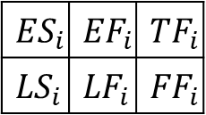
Project duration reduction
0 | 12 | 0
0 | 12 | 0
12 | 22 | 0
12 | 22 | 0
22 | 28 | 0
22 | 28 | 0
12
10
6
12 | 17 | 6
18 | 23 | 3
0 | 0 | 0
0 | 0 | 0
28 | 28 | 0
28 | 28 | 0
0
5
0
11
9
5
$${ES}_{i}$$ | $${EF}_{i}$$ | $${TF}_{i}$$
$${LS}_{i}$$ | $${LF}_{i}$$ | $${FF}_{i}$$
0 | 11 | 3
3 | 14 | 0
11 | 20 | 3
14 | 23 | 0
20 | 25 | 3
23 | 28 | 3
The makespan of the Project is 28，6 days reduction.

Slide 40
Project duration reduction
Choose minimum unit crash cost activity, reduce it’s duration.
First step：Compress the duration of activity A 4 days.
How about the project duration?

Slide 41
Project duration reduction
0 | 8 | 1
1 | 9 | 0
8 | 18 | 1
9 | 19 | 0
18 | 24 | 1
19 | 25 | 1
8
10
6
8 | 13 | 7
15 | 20 | 7
0 | 0 | 0
0 | 0 | 0
25 | 25 | 0
25 | 25 | 0
0
5
0
11
9
5
$${ES}_{i}$$ | $${EF}_{i}$$ | $${TF}_{i}$$
$${LS}_{i}$$ | $${LF}_{i}$$ | $${FF}_{i}$$
0 | 11 | 0
0 | 11 | 0
11 | 20 | 0
11 | 20 | 0
20 | 25 | 0
20 | 25 | 0
The project duration only reduces 3 days. The critical path may change when compress the activity duration.

Slide 42
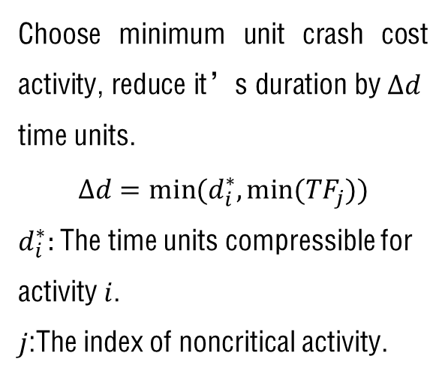
Project duration reduction
Choose minimum unit crash cost activity, reduce it’s duration by $∆d$ time units.
$$∆d=min⁡(d_{i}^{∗},min⁡({TF}_{j}))$$
$d_{i}^{∗}:$The time units compressible for activity $i$.
$j$:The index of noncritical activity.
First step：Compress the duration of activity A 3 days.

Slide 43
Project duration reduction
0 | 9 | 0
0 | 9 | 0
9 | 19 | 0
9 | 19 | 0
19 | 25 | 0
19 | 25 | 0
9
10
6
9 | 14 | 6
15 | 20 | 6
0 | 0 | 0
0 | 0 | 0
25 | 25 | 0
25 | 25 | 0
0
5
0
11
9
5
$${ES}_{i}$$ | $${EF}_{i}$$ | $${TF}_{i}$$
$${LS}_{i}$$ | $${LF}_{i}$$ | $${FF}_{i}$$
0 | 11 | 0
0 | 11 | 0
11 | 20 | 0
11 | 20 | 0
20 | 25 | 0
20 | 25 | 0

Slide 44
Project duration reduction
Second step：Compress the duration of activity A 1 days ， Compress the duration of activity B 1 days .

Slide 45
Project duration reduction
0 | 8 | 0
0 | 8 | 0
8 | 18 | 0
8 | 18 | 0
18 | 24 | 0
18 | 24 | 0
8
10
6
8 | 13 | 6
14 | 19 | 6
0 | 0 | 0
0 | 0 | 0
24 | 24 | 0
24 | 24 | 0
0
5
0
10
9
5
$${ES}_{i}$$ | $${EF}_{i}$$ | $${TF}_{i}$$
$${LS}_{i}$$ | $${LF}_{i}$$ | $${FF}_{i}$$
0 | 10 | 0
0 | 10 | 0
10 | 19 | 0
10 | 19 | 0
19 | 24 | 0
19 | 24 | 0

Slide 46
Project duration reduction
Third step： Compress the duration of activity B 2 days ， Compress the duration of activity C 2 days.

Slide 47
Project duration reduction
0 | 8 | 0
0 | 8 | 0
8 | 16 | 0
8 | 16 | 0
16 | 22 | 0
16 | 22 | 0
8
8
6
8 | 13 | 4
12 | 17 | 4
0 | 0 | 0
0 | 0 | 0
22 | 22 | 0
22 | 22 | 0
0
5
0
8
9
5
$${ES}_{i}$$ | $${EF}_{i}$$ | $${TF}_{i}$$
$${LS}_{i}$$ | $${LF}_{i}$$ | $${FF}_{i}$$
0 | 8 | 0
0 | 8 | 0
8 | 17 | 0
8 | 17 | 0
17 | 22 | 0
17 | 22 | 0
Already meet the requirement.

Slide 48

Project duration reduction
Activity | Compressed time
A | 4
B | 3
C | 2
Cost increase：
$$100×4+100×3+120×2=940$$

Slide 49



The program evaluation and review technique
Uncertainties in the project：
Facilities failure；
Resource unavailable；
Project scope change；
…
Three activity duration estimates:
（1）Optimistic time estimate$a:$This is the shortest possible time in which the activity can be completed, and assumes that everything has to go perfect.
（2）Realistic time estimate $m$: This is the most likely time in which the activity can be completed under normal circumstances.
（3）Pessimistic time estimate$b:$ This is the longest possible time the activity might need, and assumes a worst-case scenario.
Expected time：
$$t_{i}=\frac{a+4m+b}{6}$$
Variance：
$$σ_{i}^{2}=\frac{{(b−a)}^{2}}{36}$$

Slide 50

The program evaluation and review technique
Assumptions：
Activities are independent；
Critical path contains a sufficient number of activities to invoke the central limit theorem (sum of a large number of independent random variables is approximately normally distributed).
Expected project duration：$T_{E}=$sum of the expected durations of the critical activities.
Variance of the project duration ：$S^{2}=$sum of the variances of the activities along the critical path.
Statistical estimate for the probability that a project can be finished by a given due date $t$
$$P\left(T≤t\right)=φ\left(\frac{t−T_{E}}{S}\right).$$

Slide 51
The program evaluation and review technique
PERT Project example
Activity | Label | Immediate Successor | a | m | b
1 | A | B | 2 | 3 | 4
2 | B | E、F | 1 | 2 | 3
3 | C | D | 3 | 4 | 5
4 | D | F | 3 | 4 | 6
5 | E | G | 5 | 7 | 8
6 | F | G | 8 | 10 | 12
7 | G |  | 2 | 3 | 4
Calculate the probability that the project can be finished 22 days.

Slide 52



The program evaluation and review technique
0 | 3 | 6
6 | 9 | 3
3 | 5 | 6
9 | 11 | 0
5 | 12 | 6
11 | 18 | 6
0 | 0 | 0
0 | 0 | 0
18 | 21 | 0
18 | 21 | 0
3
2
7
0
3
4
4
10
0 | 4 | 0
0 | 4 | 0
4 | 8 | 0
4 | 8 | 0
8 | 18 | 0
8 | 18 | 0
$$S=\sqrt{σ_{C}^{2}+σ_{D}^{2}+σ_{F}^{2}+σ_{G}^{2}}=0.52$$
$$P\left(T≤22\right)=φ\left(\frac{22−21}{0.52}\right)≈97.26\%$$
$T_{E}=4+$4+10+3=21

Slide 53

The program evaluation and review technique
Beta distribution：
Unimodal distribution；
Adjust the shape of pdf（right-skewed distribution）;
Finite and non-negative end values.
$$f\left(x | a,b,p,q\right)=\frac{{(b−a)}^{1−(p+q)}}{B(p,q)}{(x−a)}^{p−1}{(b−x)}^{q−1},a<x<b,p>0,q>0$$

Slide 54








The program evaluation and review technique
Beta Distribution：
$$E\left(x\right)=\frac{q}{p+q}a+\frac{p}{p+q}b$$
$$V\left(x\right)=\frac{pq}{\left(p+q\right){\left(p+q\right)}^{2}}{(b−a)}^{2}$$
$$m=\frac{q−1}{p+q−2}a+\frac{p−1}{p+q−2}b$$
$$p=q=4$$
$$E\left(x|a,m,b\right)=\frac{a+4m+b}{6}$$
$$V\left(x|a,b\right)=\frac{{(b−a)}^{2}}{36}$$
$$p=3−\sqrt{2},q=3+\sqrt{2}$$
$$p=3+\sqrt{2},q=3−\sqrt{2}$$

Slide 55



Project simulation
Activity duration follows some distribution, and are independent；
Generate N numbers of samples for each activity；
Use the CPM calculate the $ES, EF, LS, LF, TF, FF$for each activity and the project makespan；
Get the distribution of the project makespan.
2 | 4
3 | 10
5 | 8
0 | 0
2 | 4
3 | 5
3 | 6
8 | 12
$$p=3−\sqrt{2},q=3+\sqrt{2}$$

Slide 56



Schedule risk analysis
Criticality Index（CI）： Probability that an activity lies on the critical path.
$$SSI=\frac{StDev\left\{Activity Duration\right\}∗CI}{StDev\{Project Duration\}}$$
Schedule Sensitivity Index（SSI）：
Cruciality Index（CRI）: The correlation between the activity estimates and total project outcome.
——Pearson’s product moment correlation：
$$ρ_{XY}=\frac{Cov(X,Y)}{σ_{X}σ_{Y}}=\frac{E(X−μ_{X})(Y−μ_{Y})}{σ_{X}σ_{Y}}$$
$$ρ_{XY}=1−6∙\frac{\sum{d_{i}^{2}}}{n^{3}−n}$$
——Spearman’s rank correlation：
$$ρ_{XY}=\frac{\left(number of concordant pairs\right)−(number of discordant pairs)}{n(n−1)/2}$$
——Kendall’s tau rank correlation：

Slide 57



Schedule risk analysis
2 | 4
3 | 10
5 | 8
0 | 0
2 | 4
$$p=3−\sqrt{2},q=3+\sqrt{2}$$
3 | 5
3 | 6
8 | 12
CI and SSI for each activity
Correlation for each activity

Slide 58
The weakness of PERT
Project example 1：serial activities
Project example 2: parallel activities

Slide 59

The weakness of PERT
Activity duration distribution：
1-49：$beta\left(2,4,3−\sqrt{2},3+\sqrt{2}\right);$
50: $beta\left(2.5,4.5,3−\sqrt{2},3+\sqrt{2}\right)。$
Calculate the probability that project 1 can be finished within 260 days, and project 2 can be finished within 6 days.
PERT：
Project 1：0.9295
Project 2：0.8674
Simulation：
Project 1：0.9291
Project 2：0.0046
A project has many noncritical paths, and the length of noncritical pathes are close to the critical path.
The variance of activity duration is very large.
The PERT may underestimate the probability that a project can be finished by a given due date.

Slide 60

Northwestern Polytechnical University
基础扎实
工作踏实
作风朴实
开拓创新

